Slide 1
Plate waste after the Healthy Hunger-Free Kids Act: Methods of Measurement, Contributing Factors, and Promising Practices
Amanda Bennett Rivera
University of Maryland School of Public Policy
Clients: Sara Pelton and Aimée Elivert
Government Accountability Office

Slide 2
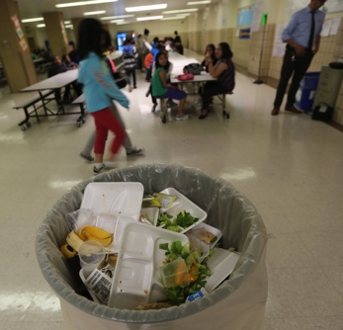
Background
The Healthy Hunger-Free Kids Act of 2010 gave the USDA authority to establish stricter nutrition standards in all foods sold in schools
Implementation began during the 2012-2013 school year
Concerns about increased plate waste levels
Source: New York Times article: “No Appetite for Good-for-You School Lunches” by Vivian Yee. Photo by Librado Romero.

Slide 3
Purpose
Determine the impact of the stricter nutritional standards of the Healthy Hunger-Free Kids Act (HHFKA) on plate waste
Identify methods to measure plate waste
Identify factors that contribute to plate waste
Identify promising practices to reduce plate waste

Slide 4
Comparison of Food Group Standards in the National School Lunch Program Before and After the Healthy Hunger-Free Kids Act
Food Group | Previous Requirements K-12 | Current Requirements K-12
Fruits and vegetables | ½ - ¾ cup of fruit and vegetables combined per day | ¾ - 1 cup of vegetables plus ½ -1 cup of fruit per day Note: Students are allowed to select ½ cup fruit or vegetable under OVS.
Vegetables | No specifications as to type of vegetable subgroup | Weekly requirement for: · dark green · red/orange · beans/peas (legumes) · starchy · other (as defined in 2010 Dietary Guidelines)
Whole grains | Encouraged but not required | At least half of the grains must be whole grain-rich beginning July 1, 2012. Beginning July 1, 2014, all grains must be whole grain rich
Milk | 1 cup Variety of fat contents allowed; flavor not restricted | 1 cup Must be fat-free(unflavored/flavored) or 1% low fat (unflavored)
Adapted from Final Rule “Nutrition Standards in the National School Lunch and School Breakfast Programs” (2012).
Notes:
Adapted from Final Rule “Nutrition Standards in the National School Lunch and School Breakfast Programs” (2012).

Slide 5
Comparison of Nutrition Standards in the National School Lunch Program Before and After the Healthy Hunger-Free Kids Act
Nutrient Standards | Previous Requirements K-12 | Current Requirements K-12
Calories | Minimum only based on grade. Lunch: 633 (grades K-3) 785 (grades 4-12) 825 (optional grades 7-12) | Minimum and maximum limits based on grade. Lunch: 550-650 (grades K-5) 600-700 (grades 6-8) 750-850 (grades 9-12)
Sodium | Reduce, no set targets | Decreasing target limits based on grade. Target I: SY 2014- 15; Target 2: SY 2017- 18; Final target: 2022- 23
Saturated fats | <10% of total calories | <10% of total calories
Trans fats | no limit | zero grams per serving (nutrition label). (Less than 0.5 grams count as zero)
Adapted from Final Rule “Nutrition Standards in the National School Lunch and School Breakfast Programs” (2012).

Slide 6
Comparing Level of Challenge SFAs Report in Implementing the Updated Meal Patterns
Adapted from Special Nutrition Program Operations Study (SN-OPS) SY 2013-14 Report. Data from SFA Director Survey SY 2012-13, questions 5.3 and 5.4; SFA Director Survey SY 2013-14, question 5.1
Notes:
Adapted from Special Nutrition Program Operations Study (SN-OPS) SY 2013-14 Report. Data from SFA Director Survey SY 2012-13, questions 5.3 and 5.4; SFA Director Survey SY 2013-14, question 5.1

Slide 7
Methodology

Slide 8
Literature Review
Based on a 2015 Congressional Research Service report: “Implementation of Updated School Meals Nutrition Standards: A Summary of Related Reports and Research”
Data collected:
  Year of data collection
  Study design/ methodology
  Setting
  Eligibility for Free and Reduced Lunch
  Selected Findings
  Limitations
  Author’s recommendations

Slide 9
Agency and Organization Website Review
Agency or Organization | Program(s)
United States Department of Agriculture (USDA) | Creative Solutions Resources & Fresh Fruit and Vegetable Program
Environmental Protection Agency (EPA) | Schools: Food Recovery Challenge
US Department of Education | Green Ribbon Schools
School Nutrition Foundation & Environmental Research and Education Foundation (EREF) | SCrAP: School Cafeteria Discard Assessments Project
National Parent Teacher Association (PTA) | Healthy School Meals Initiative
Pew Charitable Trusts | Kids' Safe and Healthful Foods Project
Cornell University | Smarter Lunchrooms Movement

Slide 10
Interviews
Luke Wolfgang, Sustainability Coordinator- US EPA Region III
Stephanie Scarmo and Mollie Van Lieu, Safe Food Project and Kids’ Safe and Healthful Food Project- Pew Charitable Trusts
Janet Hedrick- School Nutrition Foundation
Jean Ronnei, SNS, Senior Consultant- Pro-Team Foodservice Advisors
Chelsea Smyth, School Meals Fellow- National PTA
Patrice Puertollano, RD- Prince George's County Schools Food and Nutrition Services

Slide 11
Findings

Slide 12
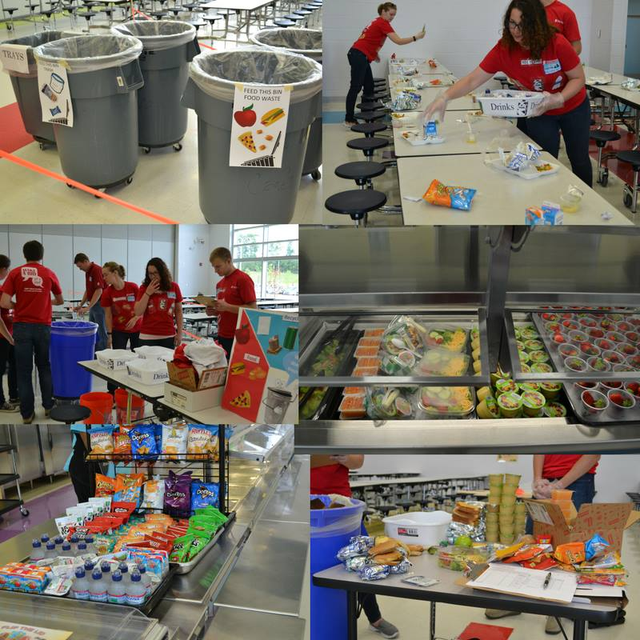
Weight and Volume Method
Source: School Cafeteria Discards Assessment Project-Scrap
https://www.facebook.com/SCRAPresearch/photos/a.1745661079050100.1073741828.1741880686094806/1834312186851655/?type=3&theater
Notes:
https://www.epa.gov/sites/production/files/2015-08/documents/r5_fd_wste_guidebk_020615.pdf

Slide 13
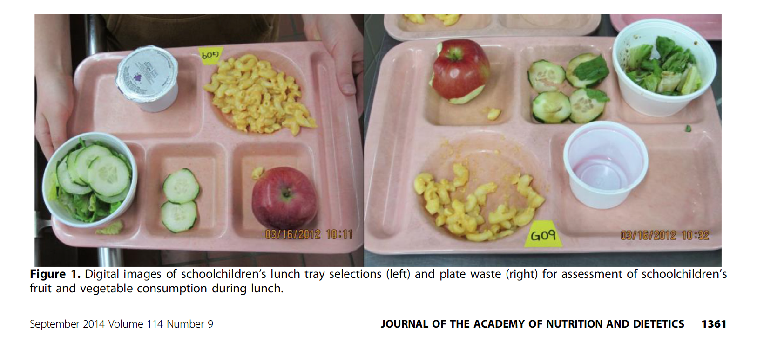
Photography
Source: Taylor, J. C., B. A. Yon, and R. K. Johnson. 2014
Notes:
Source: Taylor, J. C., B. A. Yon, and R. K. Johnson. 2014

Slide 14
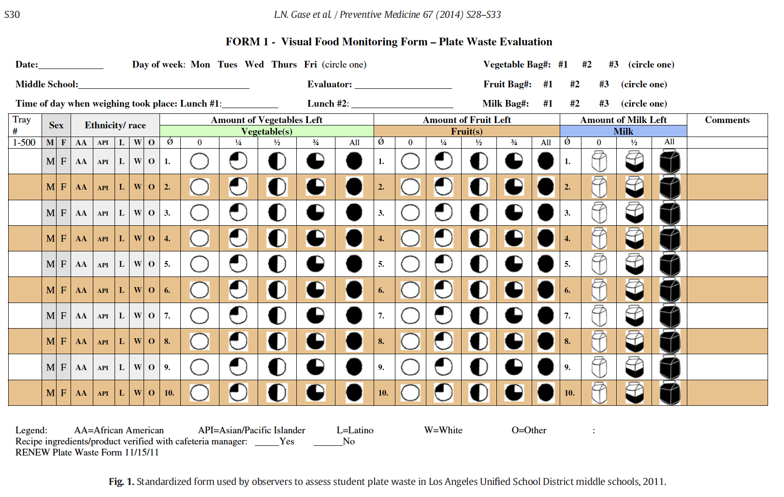
Observation
Notes:
Trading , sharing, and seconds -taylor

Slide 15

Student Recall and Interviews

Slide 16
Evaluation of Plate Waste Methodologies
Method | Weight and Volume | Photography | Observation | Student Recall and Interviews
Validity | High- Considered the golden standard | High | High | Medium
Cost | High | Medium | Low | Low

Slide 17
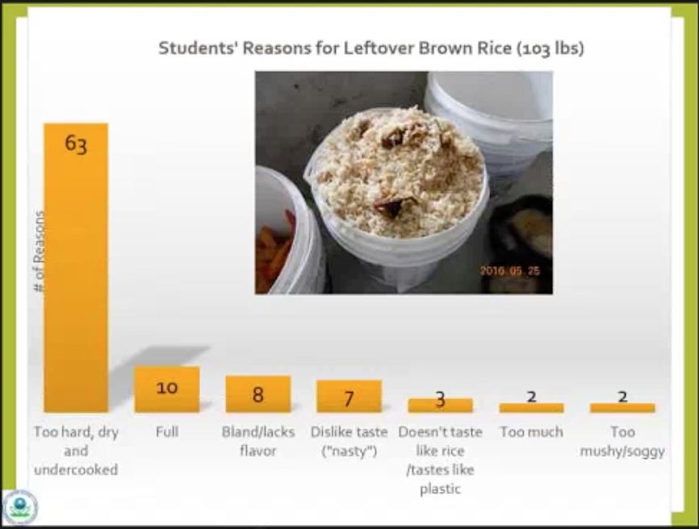
Factors Contributing to Plate Waste
Taste
Preparation
Adjustment to nutritional standard changes
Duration of lunch period
Timing of recess
Lunch shaming
Picture source: How to Conduct a School Grade 6-12 Leftover Food and Beverage Assessment. Presentation by André Villaseñor (EPA, 2017)
Notes:
Source: How to Conduct a School Grade 6-12 Leftover Food and Beverage Assessment. Presentation by André Villaseñor (EPA, 2017)

Slide 18
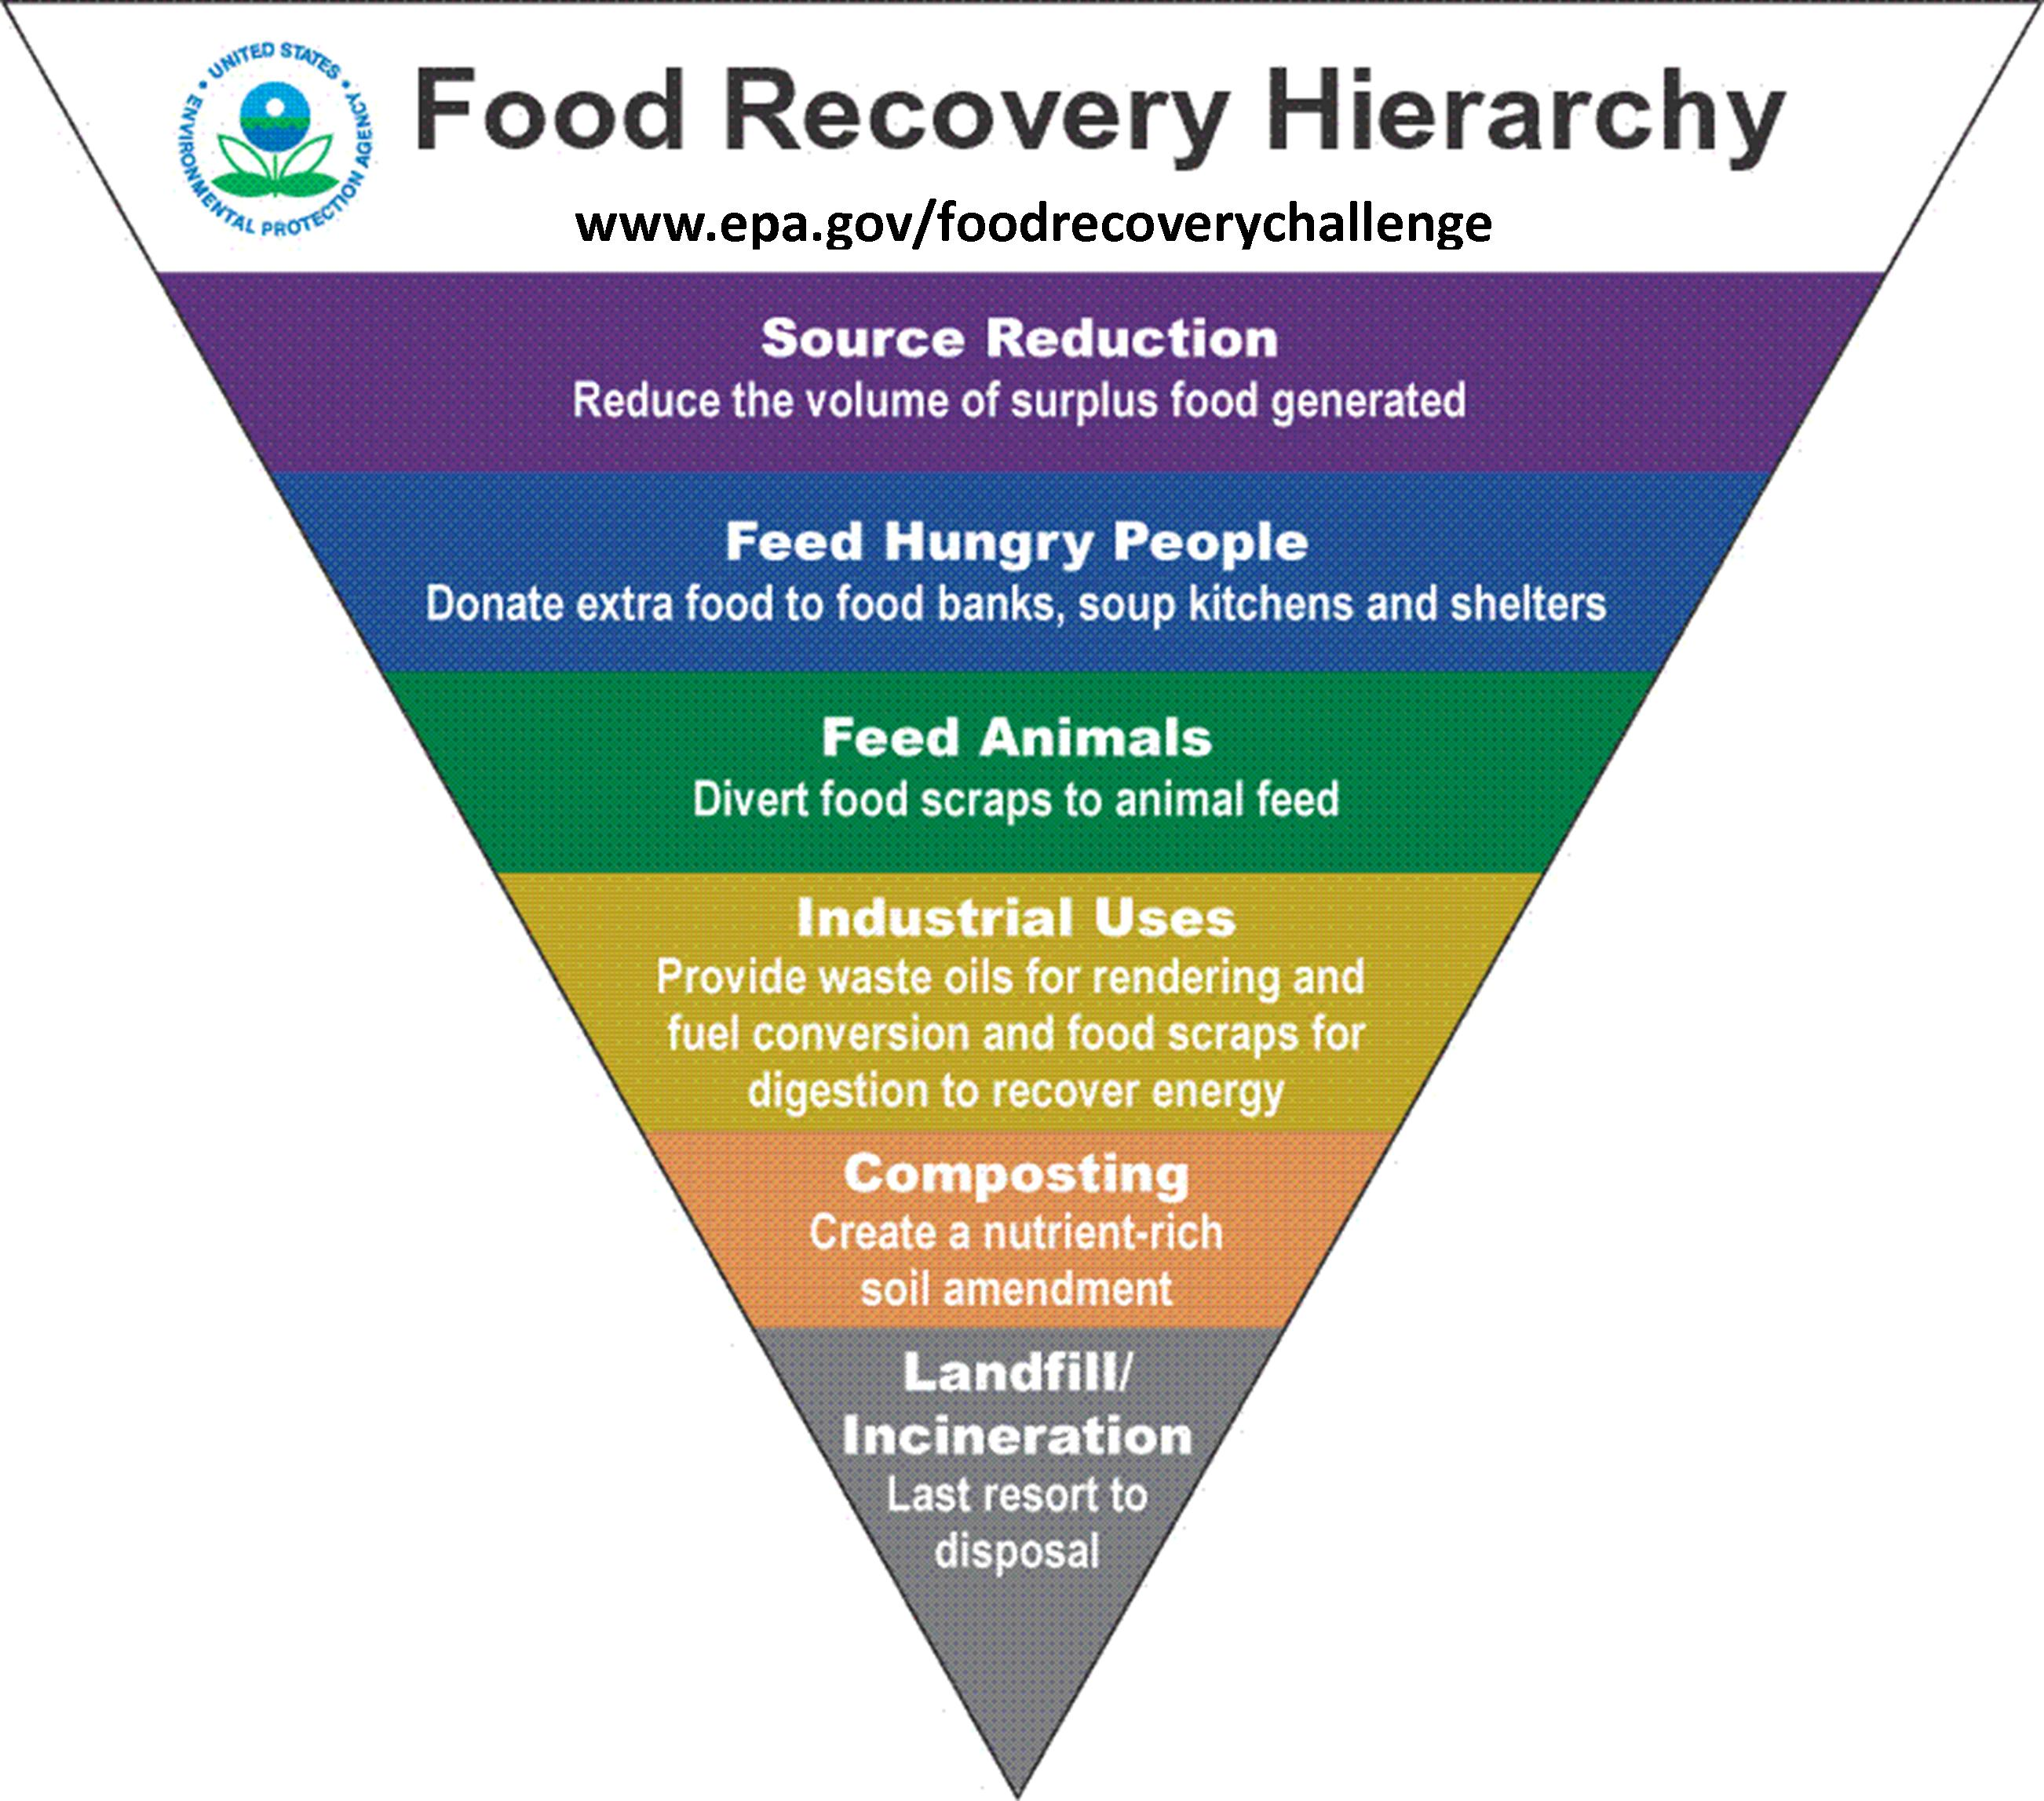
Promising Practices
Smarter Lunchrooms Movement
Keep age in mind
Offer samples of new foods
Competitive food placement
Increase lunch time
Schedule recess before lunch
Engage parents
Notes:
http://www.jneb.org/article/S1499-4046(16)30157-9/fulltext
https://www.smarterlunchrooms.org/sites/default/files/documents/SLIDES-%20August%20Workshop%20NTTT.pdf

Slide 19
Limitations
The majority of the studies included in this report focus only on the lunch program
Limited number of studies examining plate waste after the implementation of new standards
Most of the studies are not generalizable to the American population

Slide 20
Analysis & Recommendations
Address the needs of local schools
Allow children more time to become accustomed to the new nutrition standards
Conduct more research in order to increase generalizability of studies

Slide 21

Thank you
Photo: Nicholas Griner/Howard County Public School System
Source: https://www.wsj.com/articles/how-schools-can-get-children-to-eat-their-vegetables-1487944388
Notes:
PHOTO: NICHOLAS GRINER/HOWARD COUNTY PUBLIC SCHOOL SYSTEM
Source: https://www.wsj.com/articles/how-schools-can-get-children-to-eat-their-vegetables-1487944388

